Slide 1
Careers in Poultry Medicine, Poultry Welfare Programs, and Poultry Food Safety
Eric Gingerich DVM
Western University of Health Sciences
College of Veterinary Medicine
January 20, 2017

Slide 2
Outline
Poultry Veterinarians’ Goals
Associations
Post graduate training programs
Career possibilities in poultry medicine
Poultry welfare programs
Poultry food safety

Slide 3
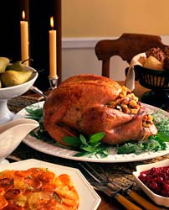
Poultry Proteins

Slide 4
American Association of Avian Pathologists (AAAP)
AAAP Mission Statement
“AAAP promotes scientific knowledge to enhance the health, well-being, and productivity of poultry to provide safe and abundant food for the world”

Slide 5
American Association of Avian Pathologists (AAAP)
60 year old association
Over 800 members
Scholarships
Preceptorships
Educational materials
Annual meeting in conjunction with AVMA annual convention
www.aaap.info

Slide 6
American College of Poultry Veterinarians (ACPV)
Certifying body for veterinarians specializing in poultry medicine
Requirements for diplomate status
Sponsor
Work experience
Passing certification test
Website - http://www.acpv.info/

Slide 7
Post Graduate Training
U of GA - Masters of Avian Medicine
NC State – Masters of Specialized Veterinary Medicine
UC Davis – Avian Diagnostic and Production Medicine
UGA – Masters of Avian Health and Medicine, online course
Mississippi State – Masters of Veterinary Science, Poultry
Ohio State – Avian Medicine Program
Purdue – Masters of Poultry Diagnostic Medicine

Slide 8
Poultry Vet Medicine Career Possibilities
Production medicine
Regulatory
Diagnostic laboratory
Technical Services
Primary breeder/hatcheries
Biologic company
Pharmaceutical
Private Consultant
Feed company
Academia/Extension
Public Health

Slide 9
Broiler Production - Broilers

Slide 10
Broiler Production - Broilers

Slide 11
Broiler Production - Breeders

Slide 12
Broiler Production-Health Management Team
Company Veterinarians
Formulate preventative medication, vaccination, monitoring, biosecurity, welfare, and sanitation programs
Work on special problem areas-condemnations, performance, Salmonella in plant, etc.
Interface between USDA and company in processing plant
Flock supervisors
Monitor program compliance
Check flocks weekly
Perform routine necropsies
Submit specimens to diagnostic laboratory

Slide 13
Broiler Company Veterinarian

Slide 14
Egg Production - Caged

Slide 15
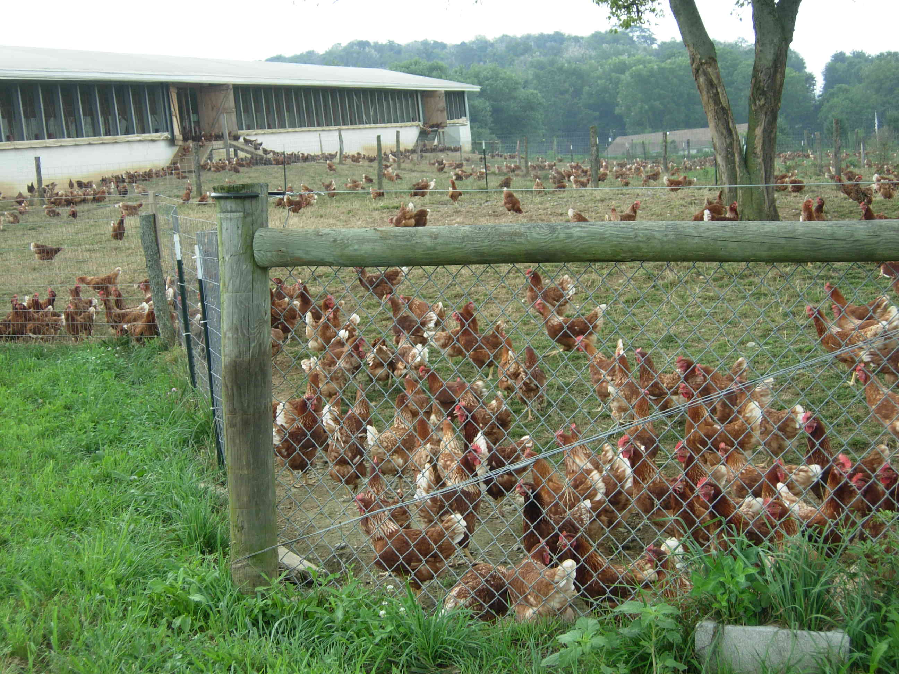
Egg Production - Cagefree

Slide 16
Egg Industry Health Management
Veterinarians
15 veterinarians employed by egg companies in US
Primary breeder, diagnostic lab, private consultant, and vaccine company vets provide a majority of health advice
Develop programs for vaccination, biosecurity, sanitation, preventative medication, diagnosis, monitoring, welfare, etc.
Flock supervisors
Employed by layer company
Perform field necropsies routinely
Weekly flock monitoring for program compliance

Slide 17
Turkey Production

Slide 18
Turkey Industry Health Management
Veterinarians
Most companies employ a veterinarian
Veterinary advice also from pharmaceutical, vaccine, diagnostic lab, and primary breeder companies
Formulate vaccination, preventative medication, sanitation, biosecurity, welfare, and monitoring programs
Interact with USDA inspectors in processing plants
Flock Supervisors
Monitor program compliance
Perform routine necropsies in field
Weekly flock checks

Slide 19
Regulatory/Public Health Veterinarians
USDA
APHIS-VS: Animal and Plant Health Inspection Service - Veterinary Services
FSIS: Food Safety Inspection Service
FDA
CDC: Center for Disease Control
CVM: Center for Veterinary Medicine

Slide 20
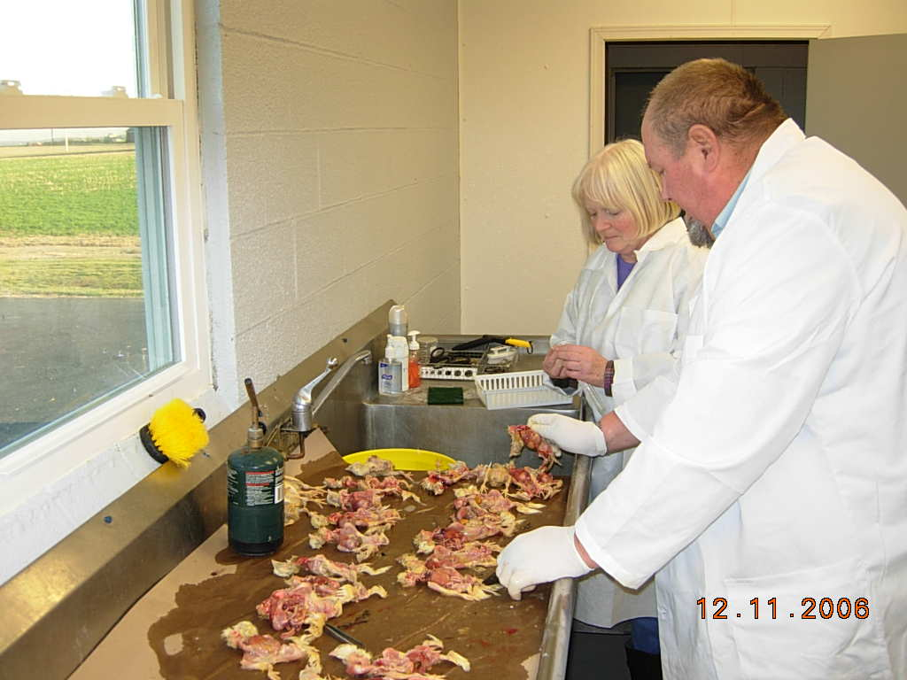
Diagnostic Lab Veterinarians
Provide diagnoses for flock problems
Pathology – gross and histopath
Request ancillary tests – bacteriology, virology, serology, toxicology, etc.
May make field visits
Field necropsies and sample collection
Management observations

Slide 21
Technical Services Poultry Veterinarians – Supplier Employed
Extensive travel
Support company’s products
Present product and research information
Help set up and conduct field trials
Monitor flocks on product
Troubleshoot flock problems
Evaluate customers flock health programs

Slide 22
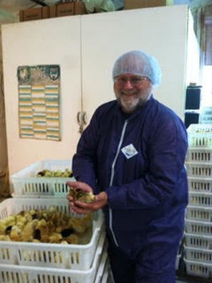
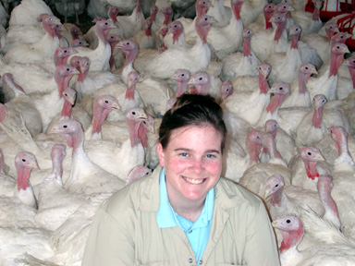
Tech Services - Self-employed Consultants
Many have worked for industry prior to becoming consultants
Contract with poultry producers to provide health management services

Slide 23
Tech Services – Primary Breeders
Employed by suppliers of genetic stocks
Support product by providing health management services to company and customers
Extensive travel – domestic and international

Slide 24
Tech Service Presentations

Slide 25
Technical Services Veterinarians

Slide 26
Flock Production Medicine
FLAWS
Feed
Lights
Air
Water
Space/Sanitation

Slide 27
Academia/Extension Veterinarians
Employed by Veterinary Schools
Teach veterinary students poultry medicine
Often have diagnostic lab duties as well
Provide education to poultry industry people

Slide 28
Academia/Extension Veterinarians

Slide 29
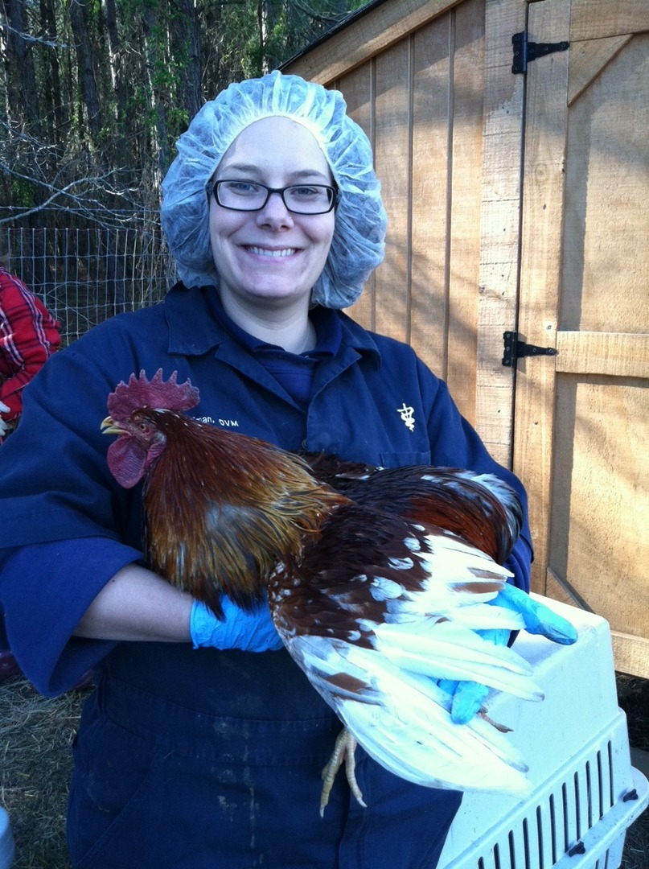
Backyard Poultry Medicine
Can be a part of any practice
Many resources available
Training at annual AVMA meeting
Books on the subject
One veterinarian opened an exclusive backyard/small flock practice in VA
Dr. Annika McKillop

Slide 30
Poultry Welfare
Standards of welfare set by various organization
Companies comply and are audited by third party auditors

Slide 31
Poultry Welfare Standards
United Egg Producers – Eggs
www.uepcertified.com
National Turkey Federation – Turkeys
www.eatturkey.com
National Chicken Council – Broilers
www.nationalchickencouncil.org
Humane Farm Animal Care – all
www.certifiedhumane.org
American Humane Association Farm Animal Care – all
www.humanehearthland.org
Animal Welfare Approved – all
www.certifiedawa.org
FACTA – all
www.factallc.com
Global Animal Partnership - all
http://www.globalanimalpartnership.org/

Slide 32
Poultry Welfare Standards
Space allotments
Disease prevention
Disease treatments
Management of the birds’ environment
Euthanasia
Transport
Handling of birds
Beak trimming
Depopulation
Inspection
Training of personnel

Slide 33
Poultry Welfare Audits
Audits performed by third party auditors
Validus
USDA
Process Management Consulting
ARPAS
Silliker
FACTA
Others
Use audits from one of the certifying bodies
Audits are pass or fail
Exit report given to describe improvements needed

Slide 34
Audits
Counting Layers in Cages to Verify Cage Density

Slide 35
Audits
Measuring Nest Area

Slide 36
PAACO – Professional Animal Auditor Certification Organization
Provides review of audits
Does not produce audits
Provides training for professional auditors by species
Poultry Welfare
Swine Welfare
Dairy Welfare
Meat Plant Welfare – beef, swine, sheep
www.animalauditor.org

Slide 37
Poultry Food Safety
Eggs – Salmonella enteritidis
FDA Egg Safety Plan
Company interventions
Meat birds
USDA testing program
Drives company interventions

Slide 38
FDA Egg Safety Plan
Specific for Salmonella enteritidis (SE)
Implemented in 2010
Used components of several states egg quality assurance programs
Negative chicks
Rodent control
Fly control
Biosecurity
Negative pullets
Cleaning and disinfection of houses
Testing

Slide 39
Drag Swabs for SE Testing

Slide 40
Egg Company SE Interventions
SE inactivated and S. typhimurium live vaccination
SE suppressing intestinal aids
Probiotics
Fermentation metabolites
Organic acids
Essential oils

Slide 41
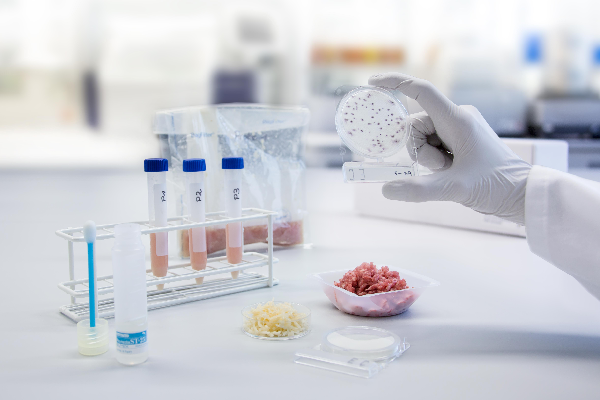
Broiler and Turkey Salmonella and Campylobacter Testing
USDA-FSIS testing
Whole bird testing
Parts testing
Ground meat testing
Testing results stimulate added or improved interventions

Slide 42
Meat Bird Salmonella and Campylobacter Preharvest Interventions
Vaccination of breeders for Salmonella
Salmonella vaccination of broilers
Bacterial pathogen suppressing gut health aids
Probiotics
Fermentation metabolites
Prebiotics
Organic acids
Essential oils
Short chain fatty acids (e.g. butyrate)
C&D of “hot” houses

Slide 43
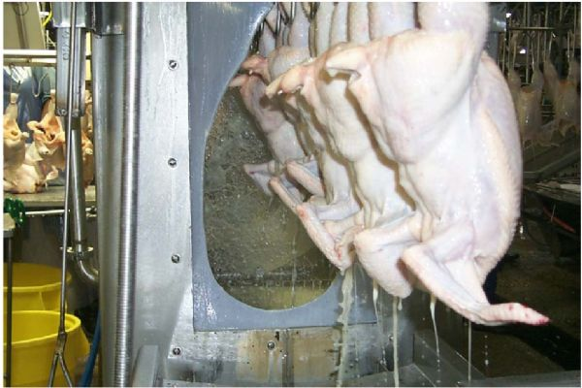
Broiler and Turkey Salmonella and Campylobacter Company Interventions
In-plant interventions
Chemical sprays and dips
pH and chlorine control of chill tank water
Tri-Sodium Phosphate Application System

Slide 44
Contact Information
Eric Gingerich DVM
Technical Services Specialist, Poultry
Diamond V
Zionsville IN
Mobile: (317) 645-6622
Email: egingerich@diamondv.com

